Slide 1

STA323
Project 1
12112627
李 乐 平
2024.4

Slide 2
Part 1
Security Data Analysis

Slide 3

Question 1
(1). Create two Spark dataframes ( df_http, df_dns ) from the files http.log.gz, dns.log.gz in folders 00 to 05 (six folders in total). Convert the ts column to Timestamp data type. Create two temp view named http_log and dns_log.
解：首先导入数据，其中需要把状态码列手动转为整型。转换ts类型，然后创建视图即可。
Department of Statistics and Data Science

Slide 4
Question 1
file_paths_http = [
"./data/task1/00/http.log.gz", "./data/task1/01/http.log.gz", "./data/task1/02/http.log.gz",
"./data/task1/03/http.log.gz", "./data/task1/04/http.log.gz", "./data/task1/05/http.log.gz"
]
file_paths_dns = [
"./data/task1/00/dns.log.gz", "./data/task1/01/dns.log.gz", "./data/task1/02/dns.log.gz",
"./data/task1/03/dns.log.gz", "./data/task1/04/dns.log.gz", "./data/task1/05/dns.log.gz"
]
df_http = spark.read.json(file_paths_http).withColumn("status_code", col("status_code").cast("int"))
df_dns = spark.read.json(file_paths_dns)
df_http = df_http.withColumn("ts", to_timestamp(df_http["ts"]))
df_dns = df_dns.withColumn("ts", to_timestamp(df_dns["ts"]))
df_http.createOrReplaceTempView("http_log")
df_dns.createOrReplaceTempView("dns_log")
Department of Statistics and Data Science

Slide 5
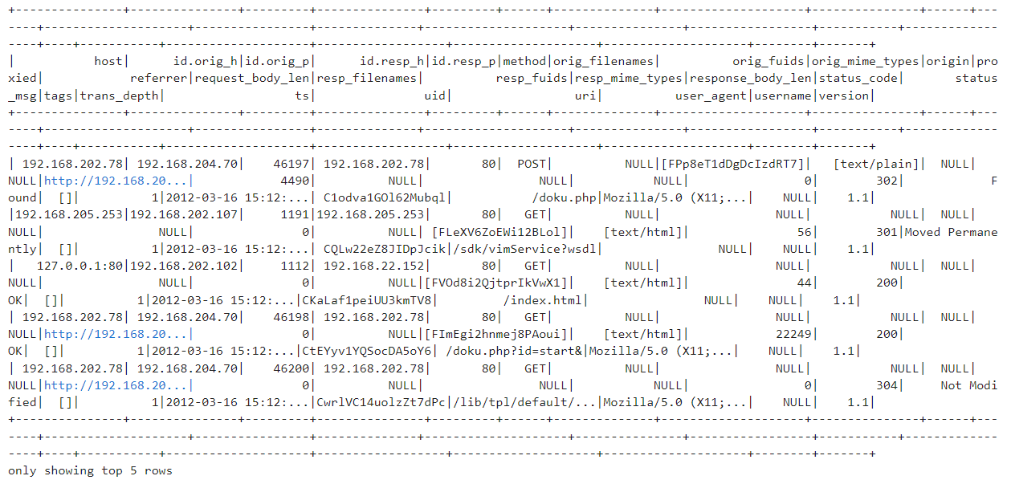
Question 1
Department of Statistics and Data Science

Slide 6
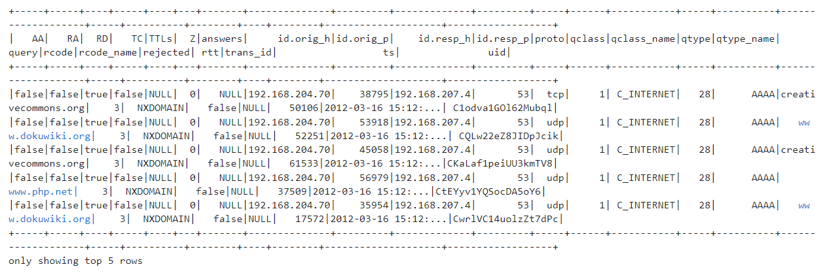
Question 1
Department of Statistics and Data Science

Slide 7
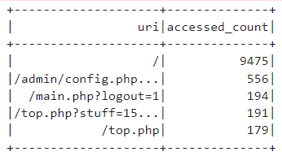
Question 1
(2). With the http_log data, filter the rows where the status code is 200 and method is GET, sort in a descending order according to the accessed count of the uri. Use Spark SQL API and Spark dataframe, seperately.
解：使用SQL查询即可。
Department of Statistics and Data Science

Slide 8
Question 1
http_log_filtered = spark.sql("""
select
uri,
count(*) as accessed_count
from
http_log
where
status_code = 200 and method = 'GET'
group by
uri
order by
accessed_count desc
""")
Department of Statistics and Data Science

Slide 9
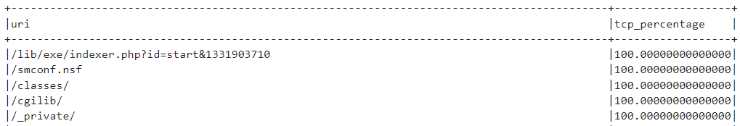
Question 1
(3). Use Spark SQL to join the http_log and dns_log tables by uid, and calculate the percentage of proto=tcp for each uri group found in task (2).
解：使用前一问的SQL作为子查询进行联合查找即可，结果共389条。
Department of Statistics and Data Science

Slide 10
Question 1
result_df_sql = spark.sql("""
select
h.uri,
100.0 * sum(case when proto = "tcp" then 1 else 0 end) / count(*) as tcp_percentage
from
(
select
uri
from
http_log
where
status_code = 200
and
method = 'GET'
group by
uri
) as selected_uris,
http_log h,
dns_log d
where
h.uid = d.uid
and
h.uri = selected_uris.uri
group by
h.uri
order by
tcp_percentage desc
""")
Department of Statistics and Data Science

Slide 11
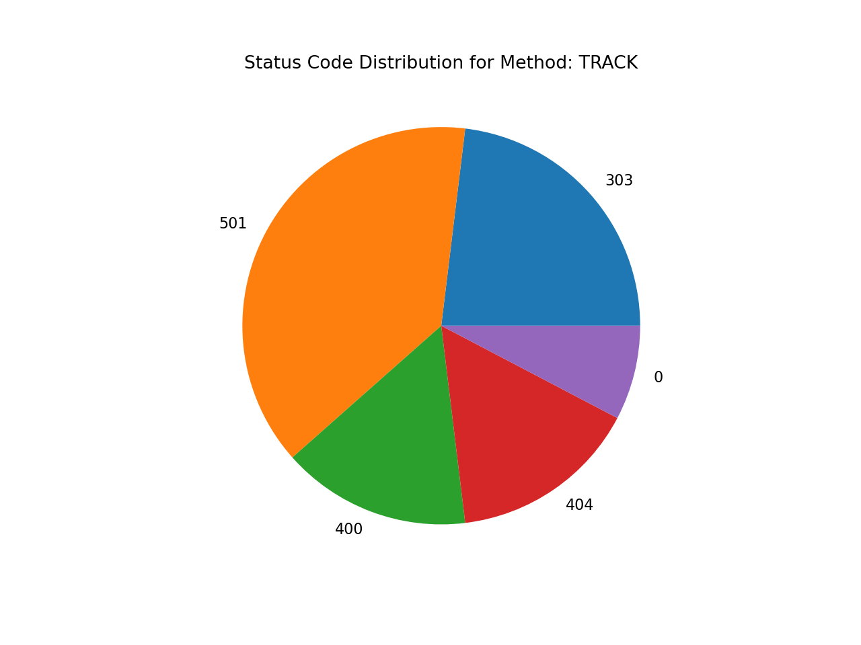
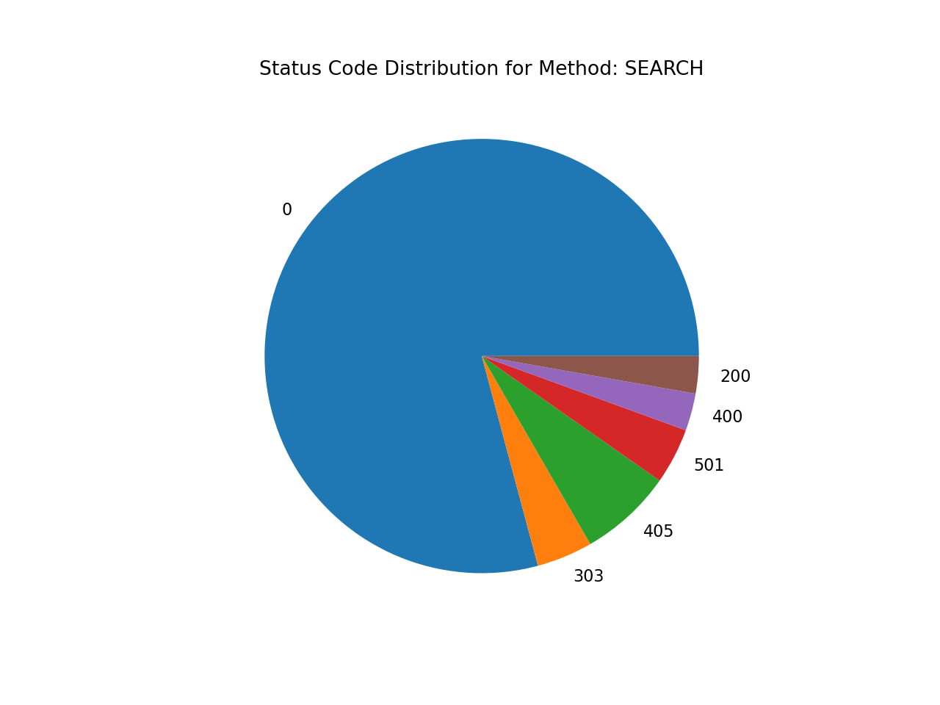
Question 1
(4). Use Spark DataFrame to calculate the percentage of different method in the http_log. Also display the pie chart of different status code for each method.
解：使用matplotlib.pyplot制作饼图并保存即可。
Department of Statistics and Data Science

Slide 12
Question 1
method_counts = df_http.groupBy("method").agg(count("*").alias("count"))
total_count = method_counts.selectExpr("sum(count) as total").collect()[0]["total"]
method_percentages = method_counts.withColumn("percentage", (col("count") / total_count) * 100)
pie_data = method_percentages.toPandas()
for method in pie_data["method"]:
method_df = df_http.filter(df_http["method"] == method)
status_counts = method_df.groupBy("status_code").agg(count("*").alias("count"))
status_data = status_counts.toPandas()
status_data["status_code"] = status_data["status_code"].fillna(0).astype(int)
plt.figure(figsize=(8, 6), dpi = 160)
plt.pie(status_data["count"], labels=status_data["status_code"])
plt.title(f"Status Code Distribution for Method: {method}")
plt.savefig(f"./output/task1/pie_chart_{method}.png")
plt.close()
Department of Statistics and Data Science

Slide 13
Part 2
Document Analysis

Slide 14

Question 2
(1). Crawl the articles of Paul Graham and store the text of the articles in folder paul_articles. Each article is located in a seperate .txt file. You can use Scrapy or any other tools you like. You can refer to the official guidelines of Scrapy here.
解：首先访问文章列表获得各文章对应的uri。然后访问爬取的uri并从中提取文章主体内容，其中需要注意自然段的分割。代码中的做法是，先提取换行标记<br>和<p>并替换为自定义的标记"^^^"，使之之后不会在get_text函数调用时被忽略。然后将原有的换行符替换为空格，因其并不能代表自然段的分割。再将标记"^^^"换为换行符，并将多余的空格删除，即可得到以正常自然段分隔的文章。
更新：似乎可以直接用.text获取正常文本，不用搞这些奇葩操作。
Department of Statistics and Data Science

Slide 15
Question 2
base_url = "https://paulgraham.com/"
base_uri = "articles.html"
base_response = requests.get(url = base_url + base_uri)
base_soup = BeautifulSoup(base_response.content, "html.parser")
hrefs = [a["href"] for a in base_soup.find_all('a') if a["href"].endswith("html")][1:]
Department of Statistics and Data Science

Slide 16
Question 2
for uri in hrefs:
response = requests.get(url = base_url + uri)
soup = BeautifulSoup(response.content, "html.parser")
font_tag = soup.find('font', size="2", face="verdana")
article_font = soup.find('font')
if article_font:
for br in article_font.find_all("br"):
br.replace_with("^^^")
for p in article_font.find_all("p"):
p.replace_with("^^^")
article_content = article_font.get_text()
article_content = article_content.replace("\n", " ")
article_content = article_content.replace("^^^", "\n")
article_content = article_content.replace(" ", " ")
article_content = article_content.replace("\n\n", "\n")
with open("./data/task2/paul_articles" + uri + ".txt", 'w', encoding='utf-8') as file:
file.write(article_content)
time.sleep(random.random() * 3)
Department of Statistics and Data Science

Slide 17
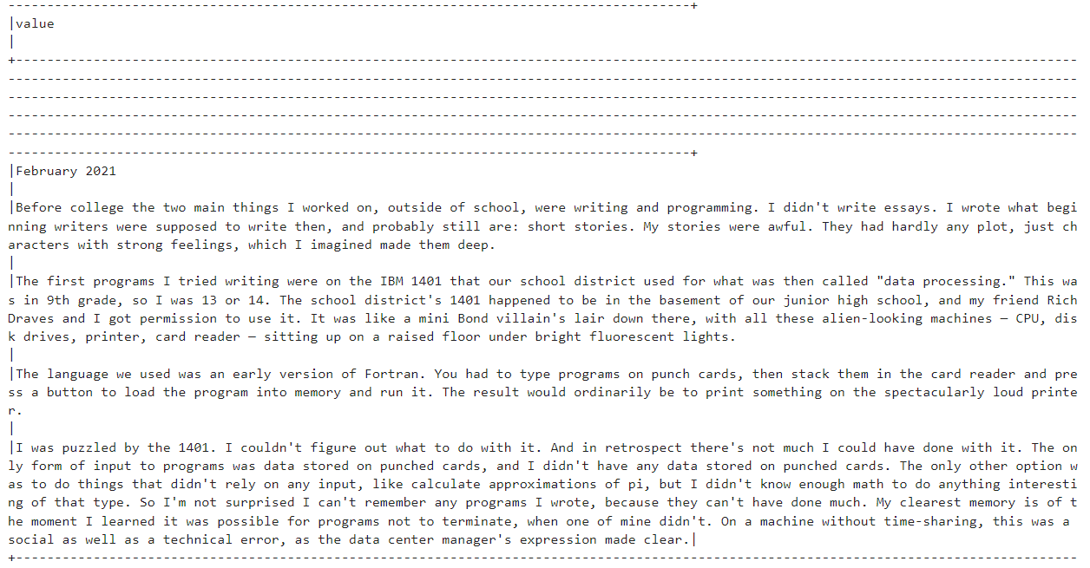
Question 2
Department of Statistics and Data Science

Slide 18
Question 2
(2). Create a dataframe by reading from these .txt files with pyspark. Each row only contains the sentences in one paragraph. Select paragraphs that are related to suggestions of career planning. You can read some examples to determine some key phrases or regrex expressions for filtering. Store all the filtered paragraphs in a parquet file career_suggestions.parquet.
解：首先读入目标目录中的.txt文件。然后筛选出与职业建议关键词相关的段落。
Department of Statistics and Data Science

Slide 19
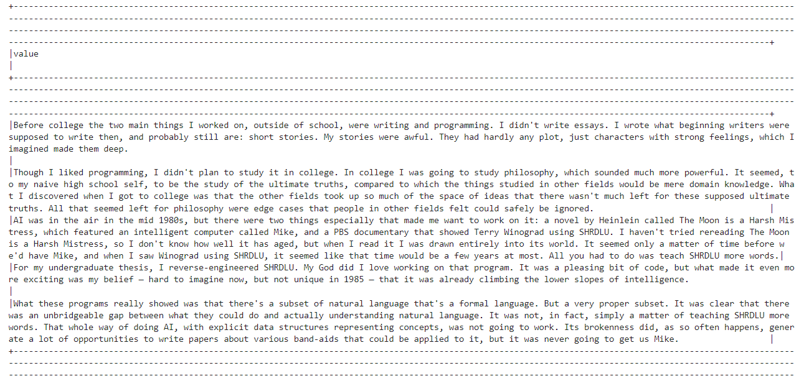
Question 2
Department of Statistics and Data Science

Slide 20
Question 2
(3). Extract noun phrases of all articles with Spark user-defined-functions and count their frequencies. You can use the Spacy Package. Plot the word cloud map with wordcloud package for the noun phrases which have the top 40~50 highest frequencies (including both end).
解：首先使用noun_chunks提取出名词片段。为使名词短语有意义，其应由2个以上的单词构成名词属性的成分，并且以名词作为开头，据此以首个单词为名词作为筛选条件。然后根据各短语出现的频数进行排序，取前40-50个绘制词云图。
Department of Statistics and Data Science

Slide 21
Question 2
nlp = spacy.load("en_core_web_sm")
def extract_noun_phrases(text):
doc = nlp(text)
return [chunk.text.lower() for chunk in doc.noun_chunks if chunk[0].pos_ == 'NOUN']
extract_noun_phrases_udf = udf(extract_noun_phrases, ArrayType(StringType()))
noun_phrases_df = text_df.select(explode(extract_noun_phrases_udf("value")).alias("noun_phrases"))
noun_phrases_df = noun_phrases_df.filter(~trim(col("noun_phrases")).rlike("^\\S+$"))
noun_phrases_df = noun_phrases_df.filter(~(col("noun_phrases").rlike(r'\b(?:a|the|an|one|this|that|your|their)\b')))
top_noun_phrases = noun_phrase_freq.select("noun_phrases", "count").collect()[39:50]
word_freq_dict = {row["noun_phrases"]: row["count"] for row in top_noun_phrases}
wordcloud = WordCloud(width=800, height=400, background_color="white").generate_from_frequencies(word_freq_dict)
plt.figure(figsize=(10, 5), dpi = 160)
plt.imshow(wordcloud, interpolation="bilinear")
plt.axis("off")
plt.show()
Department of Statistics and Data Science

Slide 22

Question 2
Department of Statistics and Data Science

Slide 23
Thanks for Watching

